Slide 1
Transaction Management and Recovery
Advanced DBMS (IGNOU MCS 043 )
Block 2 – Unit 2

Slide 2
Agenda
Transaction Processing
Protocols
  Lock based
  Timestamp based
Deadlock handling
  Prevention, Detection and Recovery
Recovery Algorithm
  Maintaining logs, shadow paging
Buffer Management

Slide 3
Transaction Processing
Transaction is a collection of operations
Logical Unit of Work
Open Account (A)
Old balance
New balance=Old bal – 500
Close Account (A)
Open Account (B)
Old balance
New balance=Old bal + 500
Close Account (B)

Slide 4
ACID Properties
Atomicity – Transactions are either fully completed or none at all
Consistency – System is in a valid state
Isolation – Multiple transactions run independently of each other
Durability – All changes made to the system are permanent

Slide 5
Serializability
In a multi-programming environment, instructions of a transaction may be interleaved with another transaction.
Schedule - Chronological sequence of a transaction.
Serial Schedule – Transactions are ordered one after the other. No concurrency
Serializable Schedule – it is non-serial schedule of transactions which is equivalent to the serial schedule.

Slide 6
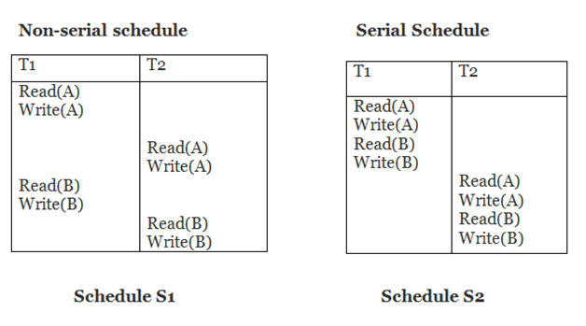
Schedule - example

Slide 7
Conflict Serializable
A schedule is said to be conflict serializable if it can be transformed into a serial schedule by swapping non-conflicting operations
Conflicting operations are those if
  They belong to different transactions
  They operate on same data item
  At least one of them is a write operation

Slide 8
Conflicting operations or not?
R(A) and W(A)
(W1(A), W2(A)) and (W1(A), R2(A))
R1(A) and W2(B)
W1(A) and W2(B)

Slide 9
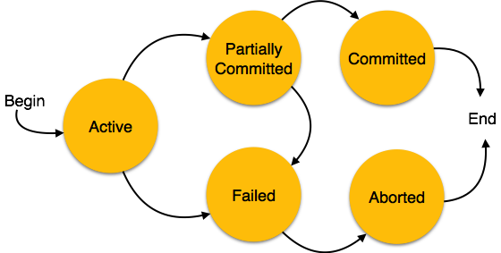
Transaction States

Slide 10
Locking Protocols
It is used to maintain consistency when many transactions are executing.
A lock is a variable associated with a data item. It can have two values:
  X mode: data item is locked for rw, cannot be shared
  S mode: data item is locked for r, can be shared among transactions
 | S | X
S | Yes | No
X | No | No
Lock Conversion
Upgrade a lock | S => X
Downgrade a lock | X => S

Slide 11
Locking Protocols
A transaction must acquire a lock on an item before acting on it. The type of lock depends on the kind of operation
Once a transaction releases a lock, it can’t acquire it again in its present lifetime

Slide 12
Pitfalls of Locking Protocols
Deadlock and Starvation
T1 | T2
Lock-X(B)
Read (B)
B = B- 500
Write (B)
 | Lock-S(A)
 | Read (A)
 | Lock-S (B)
Lock-S(A)
Notes:
T₁ holds an Exclusive lock over B, and T₂ holds a Shared lock over A. Consider Statement 7, T₂ requests for lock on B, while in Statement 8 T₁ requests lock on A. This as you may notice imposes a Deadlock as none can proceed with their execution.
Starvation – is also possible if concurrency control manager is badly designed. For example: A transaction may be waiting for an X-lock on an item, while a sequence of other transactions request and are granted an S-lock on the same item. This may be avoided if the concurrency control manager is properly designed.

Slide 13
Two-phase locking
Assures serializability
May not prevent deadlocks
Growing phase – new locks are acquired, can’t be released
  Acquire S-lock on an item
  Acquire X-lock on an item
  Upgrade S-lock to X-lock
Shrinking phase – existing locks are released, but no new locks acquired
  Release S-lock on an item
  Release X-lock on an item
  Downgrade X-lock to S-lock
Notes:
https://www.javatpoint.com/dbms-lock-based-protocol

Slide 14
Updates using 2PL
Time | T1 | T2 | Balance
T1 |  | Begin transaction | 100
T2 | Begin transaction | Lock-X(Balance) | 100
T3 | Lock-X (Balance) | Read (Balance) | 100
T4 | WAIT | Balance += 100 | 100
T5 | WAIT | Write (Balance) | 200
T6 | WAIT | Commit; Unlock(Balance) | 200
T7 | Read (Balance) |  | 200
T8 | Balance -= 10 |  | 200
T9 | Write (Balance) |  | 190
T10 | Commit; Unlock(Balance) |  | 190
Notes:
T1 and T2 are concurrent transactions. T2 is older than T1 as T2 started before T1.
T2 acquires an exclusive write lock on Balance, increments its value by 100 and commits the record. (Growing phase and Shrinking phase)
T1 has to wait until T2 releases the lock. Then it decrements its value by 10.
Updates done by both old and new transactions show their effect on the value of the data item.

Slide 15
Prevention of Uncommitted Dependency
Time | T1 | T2 | Balance
T1 |  | Begin transaction | 100
T2 | Begin transaction | Lock-X(Balance) | 100
T3 | Lock-X (Balance) | Read (Balance) | 100
T4 | WAIT | Balance += 100 | 100
T5 | WAIT | Write (Balance) | 200
T6 | WAIT | Rollback; Unlock(Balance) | 100
T7 | Read (Balance) |  | 100
T8 | Balance -= 10 |  | 100
T9 | Write (Balance) |  | 90
T10 | Commit; Unlock(Balance) |  | 90
Notes:
T1 and T2 are concurrent transactions. T2 is older than T1 as T2 started before T1.
T2 acquires an exclusive write lock on Balance, increments its value by 100 and rollbacks the record. (Growing phase and Shrinking phase)
Value of the item is restored to 100
T1 has to wait until T2 releases the lock. Then it decrements its value by 10.
Inconsistency of data has been preventeds

Slide 16
Locking Implementation
Lock Manager – A process to which all transactions send lock and unlock requests.
Lock table – A data structure maintained by the lock manager
Black rectangles indicate granted locks, white ones indicate waiting requests

Slide 17
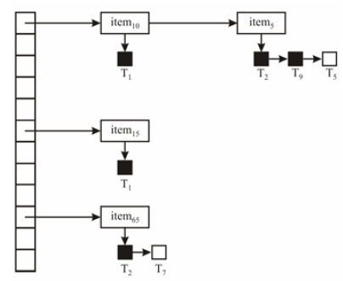
Lock Table

Slide 18
Graph Based Protocol
Tree Protocol
  Only exclusive locks are permitted
  First lock can be acquired on any data item
  A data item can be locked only if its parent is locked
  Unlock at any time

Slide 19
Tree based Protocol
A
Lock A
Lock G
B
C
D
E
F
G

Slide 20
Tree based Protocol
Advantages
  Has shorter waiting time and increased concurrency
  Ensures freedom from deadlocks
  Upon aborting a transaction, it can lead to cascading rollbacks
Disadvantages
  Prior knowledge of data access
  Unnecessary locks

Slide 21
Phantom Read
A transaction T executes and retrieves a set of tuples. When it re-executes the transaction at a later time, the retrieved set contains additional phantom records.
It has been inserted by another transaction. This is called phantom read
Solution: Index Locking Protocol

Slide 22
Timestamp-based Protocols
These are concurrency control protocols
Each transaction is issued a timestamp based on its start time. It is generated using a system clock or a counter
IF transaction T1 started before T2, then TS(T1)<TS(T2)
Time stamps determine the serializability order
Each data item has two timestamps
  W-timestamp(Q)
  R-timestamp(Q)
Notes:
W-timestamp is the largest timestamp of any transaction that executed a write operation on Q successfully
R-timestamp is the largest timestamp of any transaction that executed a read operation on Q successfully

Slide 23
Timestamp-based Protocols
Suppose a transaction Ti issues a read(Q):
If TS(Ti) <W-timestamp(Q), ⇒ Ti needs to read a value of Q that was already overwritten. Action: reject read operation and rolled back Ti .
If TS(Ti)≥ W-timestamp(Q), ⇒ It is OK. Action: Execute read operation and set R-timestamp(Q) to the maximum of R-timestamp(Q) and TS(Ti).

Slide 24
Timestamp-based Protocols
Suppose that transaction Ti issues write (Q):
If TS(Ti) < R-timestamp(Q), ⇒ the value of Q that Ti is writing was used previously, this value should have never been produced. Action: Reject the write operation. Roll back Ti
2) If TS(Ti) < W-timestamp(Q), ⇒ Ti is trying to write an obsolete value of Q. Action: Reject write operation, and roll back Ti.
3) Otherwise, execute write operation, and set W-timestamp(Q) to TS(Ti).

Slide 25
Timestamp-based Protocols
It guarantees serializability ie arcs in the precedence graph do not form any cycles
Gives freedom from deadlocks
Transaction with smaller TS
Transaction with larger TS

Slide 26
Timestamp-based Protocols
Suppose Ti aborts, but Tj has read a data item written by Ti
Then Tj must also be aborted; if Tj had committed earlier, the schedule is not recoverable
Also, any transaction that has read a data item written by Tj must abort too. Thus, there may occur a cascading rollback − that is, a chain of rollbacks.

Slide 27
Timestamp-based Protocols
Solution:
A transaction is structured in such a manner that all the writes are performed at the end of its processing.
All such writes of a transaction form an atomic action; no transaction may execute while a transaction is being written.
A transaction that aborts or is rolled back is restarted with a new timestamp.

Slide 28
Thomas Write Rule

Slide 29
Deadlock Prevention
Wait-die scheme (non-preemptive)
  Older transaction may wait for younger one to release data item. Younger transactions never wait for older ones; they are rolled back instead.
  A transaction may die several times before acquiring the needed data item
Wound-wait scheme (preemptive)
  Older transaction wounds (forces rollback) of younger transaction instead of waiting for it. Younger transactions may wait for older ones.
  May be fewer rollbacks than wait-die scheme.

Slide 30
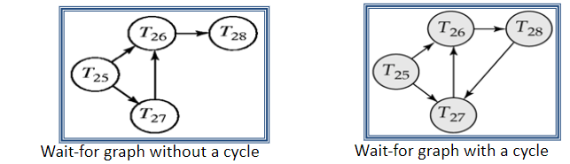
Deadlock Detection

Slide 31
Recovery Algorithms
These are techniques used to ensure db consistency despite failures
Two parts of a recovery algorithm:
  Action taken during normal transaction processing
  Action taken after a failure
Two approaches:
  Log-based recovery
  Shadow paging

Slide 32
Log-based Recovery
A log is a widely used structure to record db modifications
Update log record: <Ti, X, old, new>
<Ti, commit>
<Ti, abort>
Two techniques for using logs:
  Deferred db modification
  Immediate db modification

Slide 33
Deferred DB Modification
All changes are stored in the log
All writes to db are deferred to after partial commit
    <Ti start>
    <Ti X V> where V is the new value
    Ti partially commits
    <Ti commit>
    Data written to db
During recovery after failure, a transaction is redone only if <Ti start> and <Ti commit> are present in the log

Slide 34
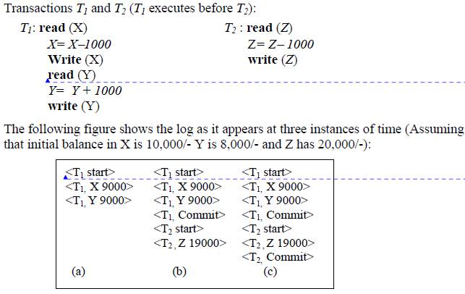
Deferred DB Modification - Example
Notes:
For If log on stable storage at the time of crash as per (a) (b) and (c) then in:
No redo action needs to be performed.
redo(T1) must be performed since <T1 commit> is present
redo(T1) must be performed followed by redo(T2) since <T1 commit> and <T2 commit> are present.

Slide 35
Immediate DB Modification
Allows db updates even on un-committed transactions
Logs store old and new values
Logs are written before db item is written

Slide 36
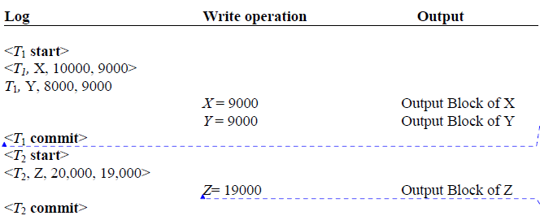
Immediate DB Modification - Example

Slide 37
Immediate DB Modification
Recovery procedure has two operations
  Undo(Ti) – restore old values
  Redo(Ti) – update to new values
These operations are idempotent ie even if executed multiple times, it has the same effect.
They may be executed many times during recovery
Recovering from a failure:
  Undo(Ti), if the log has <Ti, start> and not <Ti, commit>
  Redo(Ti), if the log has <Ti, start> and <Ti, commit>
Undo done before redo

Slide 38
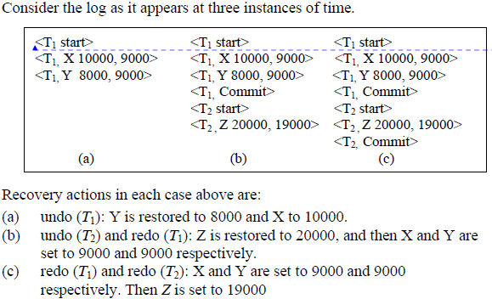
Immediate DB Modification - Example

Slide 39
Checkpoints
To streamline recovery process
mechanism where all the previous logs are removed from the system and stored permanently in a storage disk.
Checkpoint declares a point before which the DBMS was in consistent state, and all the transactions were committed

Slide 40
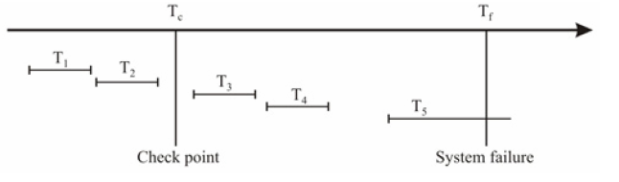
Checkpoints
During the recovery process:
T1 and T2 can be ignored
T3 and T4 are redone
T5 is undone

Slide 41
Shadow Paging
Alternative to log-based recovery
It maintains 2 pages: current page and shadow page
No overhead of writing log records
Recovery is trivial

Slide 42
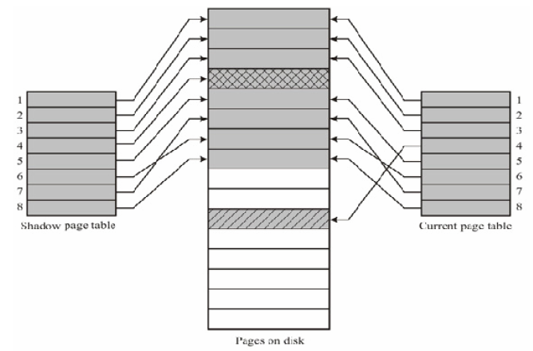
Shadow Paging

Slide 43
Shadow Paging Drawbacks
Commit overhead
Data Fragmentation
Works only for serial transactions, hard to extend it for concurrent transactions
Garbage collection

Slide 44
Thank You

